Slide 1
Data as the foundation of successful digital transformation in the financial segment
Radenko Baković
Business Development Manager
December 2023

Slide 2

How to centralize your data?
How to access different data types?
How to increase value of available data?
How to use data to simplify our work?

Slide 3
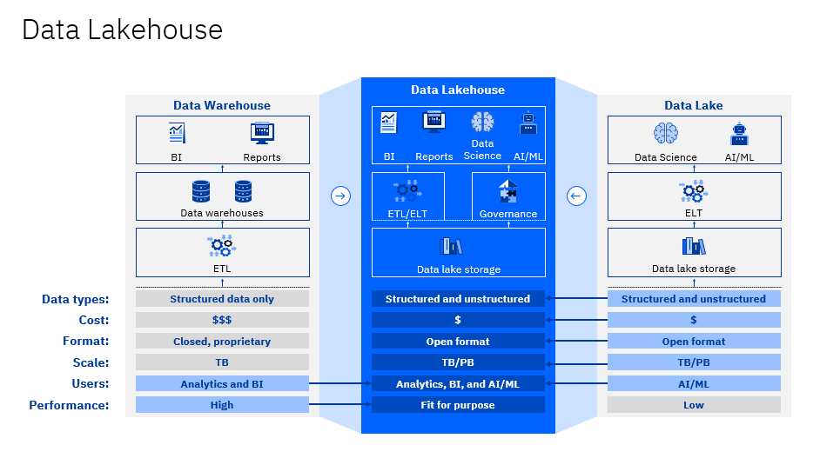

Slide 4

How to centralize your data?
How to access different data types?
How to increase value of available data?
How to use data to simplify our work?

Slide 5

Monetize your data
01
Data
Modernize your data
02
Cloud
scalable, adaptable and secure services, for excellent performance
Solutions
Data is main resource for new business utilization
Key Benefits
      Improving business decisions in real time;
      Evaluating organizations’ performance;
      Resolving Excel and traditional systems bottlenecks and issues;
      Creating interactive management dashboards across devices;
      Self-service BI and data preparation for advanced users;
      Decreasing dependency on IT department for reports and analysis;
      Simplified administration, lower TCO and IT costs
01
Processes
optimize processes to control business
08
Modernize your data
03
Marketing & sales
automation
understand clients before they realize that you do not understand them
ICT
strong infrastructure, foundation of strong growth
Data Lakehouse and AI
07
API Management connect all the dots
04
ECM
control documentation and bust corporate governance
Security
secure your clients and your business
06
05

Slide 6
How to centralize your data?
How to access different data types?
How to increase value of available data?
How to use data to simplify our work?
BUT!

Slide 7
How to trust your data?
How to enforce data quality?

Slide 8
Data Management Strategy
Regulatory Compliance
BCBS 239
Self-service BI
Data Processing & Visualization Improvement
Data Governance
Business Growth & Innovation Enablers
Local regulation
Group requirements
Data ownership, dictionary, linage, access and change control
Advanced visualization
Shared data model
Report industrialization
Profitability analytics
Golden data source
GDPR
Campaign management
Data Management Office
Real-time processing
Risk scoring and modelling
ETL standardization
Data quality monitoring and correction process
Data-driven Culture
EU Taxonomy
ESRS
CSRD

Slide 9
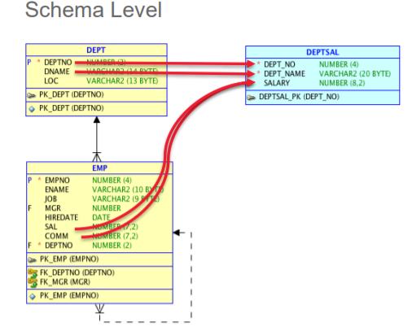
Data Lineage
Data Lineage
The process of understanding, documenting and visualizing the data and its transformations from its origin to the utilization.
It provides deep understanding of data sourcing and alterations along the way to consumers as well as explains how information is used
Benefits for Business and IT side:
Better understanding and trust in data, improves data transparency
Ensures regulatory compliance
Facilitates data quality management and improvements by enabling root cause analysis
Makes downstream impact revealed and understandable
Enhances data governance
Supports data security, data privacy and GDPR efforts
Improves efficiency of data managing staff by providing clear understanding of data sourcing and transformations involved

Slide 10
How to trust your data?
How to enforce data quality?
How to be proactive and generate meaningfull data?

Slide 11
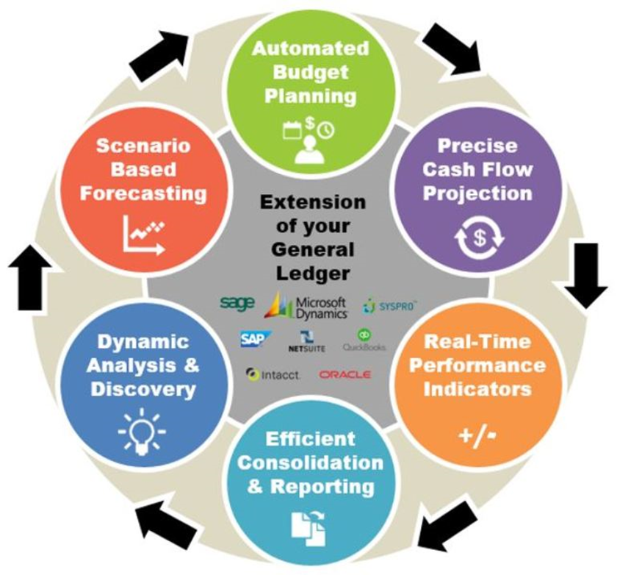
Planning&Budgeting
Financial planning and budgeting are critical components of banking operations
Requiring accuracy and attention to detail
By using EPM solutions, banks are able to
  streamline their financial planning process by consolidating data from multiple sources into a single system
  automate repetitive, time-consuming tasks, such as data entry, reconciliation, and consolidation
  improve the quality of financial reporting as it increases reliability of the data being used in the process
Reducing the risk of errors and freeing up staff to focus on value-added activities!
Notes:
Sada prelazimo na drugu temu današnje prezentacije a to je EPM rješenje za planiranje i budžetiranje. Svjesni smo da je proces budžetiranja i planirama u bankama jedan on nadjužih i komplikovanijih procesa, koji uključuje jako puno stakeholdera, od izvršioca do najvišeg nivoa menadžmeta. To je proces koji zahtjeva tačnost i orijentsanog na detalja, a svaka greška u istom može dovesti do katastrofalnih posljedica po poslovanje banke.
Rješenja za automatizaciju ovog procesa nude automatizirano budžetiranje, precizne projekcije novčanog toka, indikatore koji se koriste u realnom vremenu, konsolidaciju, izvještavanje, te dinamičke analize i buduže prognoziranje.
Dakle, EPM je alat koji pojedonostavljuje i automatiria navedeni proces, pogotovo ponavljajuče taskove kojih ima jako puno u ovom procesu, i što je najvažnije poboljšavanja pouzdanost korištenih podataka te oslobađa ljudske resurse od ovakvkih aktivnosti kako bi se mogli fokusirati na aktivnosti koje nose određenu dodatnu vrijednost za instituciju.

Slide 12
How to trust your data?
How to enforce data quality?
?
How to be proactive and generate meaningfull data?

Slide 13




Key business challenges
ESG
disclosures
GHG calculation
and reporting
Achieving
decarbonization
targets
Driving engagement
and action
That´s right! These are business challenges!
Notes:
Business success requires new levels of resilience and agility, rooted in responsible practices that preserve the planet for future generations. Talking around being sustainable is one thing but finding a path to successful action is another. Forbes reported “Although 90% of executives think sustainability is important, only 60% of companies have a sustainability strategy.” This is because of the challenges that clients are experiencing when it comes to implementing sustainability strategies. If sustainability were easy, everyone would be doing it.
The core challenges that companies have been faced with revolve around the pressure to progress toward more sustainable and socially responsible business operations, and to be able to actually attain some of their reduction targets. Along with this is stakeholder management. As previously mentioned, there is a growing number of stakeholders to manage, including investors, consumers, employees, and governments. As this is really happening for the first time across industries, one of the most crucial challenges is managing and operationalizing sustainability data across siloed sources and evolving reporting datasets. All the information that's required to create sustainability data is actually in raw data sources owned by utility companies or in interval meters. Thus, while organizations recognize this need for sustainability performance management, and feel the pressure of the movement, clients are still struggling. Further business challenges include:
ESG Disclosures: This is one of the core challenges for businesses because investors are increasingly demanding that organizations publicly disclose their Environmental, Social, Governance (ESG) and Greenhouse Gas (GHG) credentials to external ESG agencies and frameworks, and in accordance with an increasing number of ESG reporting standards. However not all organizations have the tools or analytics to do this in an accurate and efficient manner.
GHG reporting: One of the most difficult parts of ESG disclosures is GHG reporting. GHG reporting covers not only an organization’s operations, but also the upstream supply chain and downstream distribution and products sold. For example, when a consumer purchases a bicycle from Costco, emissions are generated from creating the bicycle itself (upstream), as well as, the emissions generated from gas and shipping of the product to Costco warehouses worldwide (downstream). For large organizations, it typically involves bringing together thousands or tens of thousands of individual data streams on an ongoing basis from dozens or hundreds of different data sources. Moreover, metrics like carbon dioxide (CO2) footprint calculations are externally benchmarked, need to be of financial grade, and need to be fully auditable. And once again, many organizations today lack the tools needed to achieve this.
Achieving decarbonization targets: Companies want to reduce their carbon emission, but many currently lack a roadmap to achieve this target. The purpose around sustainable businesses is to not just set a goal but to successfully attain it. Organizations feel all of the pressures previously mentioned; however without a roadmap in place, they will forever struggle to achieve their decarbonization goals.
Driving engagement and action: In response to investor and market pressure, companies are making GHG net zero commitments in record numbers. For example, the Energy and Climate Intelligence Unit and Oxford Net Zero reported “1 in 5 of the world’s 2,000 largest publicly listed companies have committed to net zero.” But again, it’s one thing to make a net zero commitment for a future date, and another to mobilize a large organization to make steady progress towards those commitments. IBM has even committed to net zero GHG emissions by 2030 and continually takes steps towards achieving this.
Sources:
Why Corporate Strategies Should Be Focused On Sustainability (Forbes)
https://www.forbes.com/sites/forbesbusinesscouncil/2021/02/10/why-corporate-strategies-should-be-focused-on-sustainability/?sh=3b27c0967e9f
Researchers outline decarbonization scenarios to meet targets (Environmental Journal)
https://environmentjournal.ca/researchers-outline-decarbonization-scenarios-to-meet-targets/
Report: Fifth of world’s largest companies now have net zero target (Energy and Climate Intelligence Unit)
https://eciu.net/media/press-releases/2021/report-fifth-of-worlds-largest-companies-now-have-net-zero-target

Slide 14

Common gaps across key disclosure areas
Utility billing data
Water
Waste and recycling
Electricity
Gas
Fuels
Solar
Water, waste water
Waste and recycling data types
Scope 1 Emissions
Scope 2 Emissions
Scope 3 Supply Chain emissions
On-site fuels
RECs, green power, market-based emissions
Across 15
Scope 3 categories
Social indicators
Governance indicators
Targets
Community investment, donations, volunteer hours
Headcount, rooms, beds, meals, sales
Across all indicators
Notes:
Presented on this slide are common areas of disclosures for manufacturers, along with some common gaps or blind spots. There are many external Environmental, Social, Governance (ESG) agencies and frameworks, including Global Reporting Initiative (GRI), Sustainability Accounting Standards Board (SASB), Carbon Disclosure Project (CDP), Task Force on Climate-Related Financial Disclosures (TCFD), and the United Nation’s Sustainable Development Goals (UNSDGs). Organizations must disclose certain information to some frameworks but not others.
To close these gaps, organizations need the right tools to collect information about energy factors, water, waste and recycling, and get into all of the relevant factors and emission factors associated with Scope 1, Scope 2, and Scope 3. As well, organizations need a way to capture information through existing systems of record and then marry them against targets.
Note:
The GHG Protocol categorizes greenhouse gas emissions into three ‘Scopes.’ Scope 1 covers direct emissions from owned or controlled sources, such as vehicles and fuel combustion. An example of Scope 1 emissions is fleet fuel used for an organization’s vehicle fleet. Scope 2 covers indirect emissions from the generation of purchased electricity, steam, heating, and cooling. An example of Scope 2 emissions is the emissions from the electricity an organization purchases to cool their data centres. Scope 3 covers indirect emissions such as purchased goods and services and business travel. An example of Scope 3 emissions is emissions from FedEx that was hired from the government (or any shipping company that was hired for that matter) to refrigerate and ship cold chain custody vaccines during the COVID-19 pandemic.
Acronym:
REC’s: Renewable Energy Certificates
Sources:
Greenhouse Gas Protocol
https://ghgprotocol.org/about-us
GHG Protocol Scope 2 Guidance
https://ghgprotocol.org/sites/default/files/Scope2_ExecSum_Final.pdf
Briefing: What are Scope 3 emissions? (Carbon Trust)
https://www.carbontrust.com/resources/briefing-what-are-scope-3-emissions
What are scope 1, 2 and 3 carbon emissions? (National grid)
https://www.nationalgrid.com/stories/energy-explained/what-are-scope-1-2-3-carbon-emissions
What Is ESG Reporting, and Why Is It Important? (Sustainability Knowledge Group): https://sustainabilityknowledgegroup.com/what-is-esg-reporting-and-why-is-it-important/

Slide 15
How to address key pain points?
Build
Data foundation
A single system of record that delivers auditable, financial grade sustainability data
Streamline
Reporting & disclosure
Flexible reporting tools
to meet internal and
external requirements
Accelerate
Decarbonization
Unlock insights to inform the fastest and most cost-effective pathway to low carbon goal
Notes:
Envizi helps clients at every step of their sustainability journey, whether they need to consolidate their data, streamline reporting, identify efficiency and emission reduction opportunities, or inform business strategy. One of the things that makes Envizi unique is that it doesn’t just stop at reporting. Envizi has technology that enables clients to engage stakeholders across their business and accelerate progress against their decarbonization goals. The ultimate outcome of Envizi is to help organizations build a data foundation, streamline reporting, engage teams, and accelerate decarbonization.
Build a data foundation: Clients are rarely starting from a blank slate. In many cases, they may have already been using a data management platform, Excel spreadsheets, or other internal systems, but are still lacking a strong data foundation. By providing a rich set of data management tools to ensure quality data, clients can automatically capture any data required for reporting and decision-making and consolidate all sustainability and energy data from across an organization in a robust and auditable single system of record that allows clients to report with confidence.
Streamline reporting and disclosure: Clients can reduce the reporting burden by leveraging Envizi’s rich set of tools such as predefined dashboards and reporting templates, as well as a highly flexible and customizable embedded Microsoft PowerBI engine, for users to visualize their data and produce their reports (whether for external purposes, internal purposes, or disclosures). The PowerBI engine is fully integrated into the Envizi user interface allowing organizations to customize out-of-the-box dashboards or create custom dashboards to align with targeted business needs. PowerBI can enhance the dashboards or reports produced to support the various modules that clients are subscribing to. As an alternative, Envizi can push application programming interface (API) data into clients’ enterprise version of their own PowerBI, Tableau, Cognos, or any other business intelligence tool.
Accelerate decarbonization: With targets in place to reduce emissions, organizations are moving quickly to turn sustainability ambition into action. Clients can leverage Envizi’s powerful analytics engine to deliver insights from across the enterprise right down to site level and equipment specific performance, to determine the fastest and most cost-effective way to reach emissions reduction goals.

Slide 16





Envizi consolidates sustainability data from providers
Powerful ESG data capture
Customizable ESG reporting
500+ data types
Reports for every audience
Automatic data capture:
Driving ESG performance improvements:
Bill pay providers
Streamlined ESG data consolidation
Email, FTP, EDI, API
Auditable single system of record
Executive
reporting
ESG performance reporting
Data aggregators
Third-party providers
Data service hub
Benchmarking
Flexible reporting granularity
Flexible organization hierarchy
Meeting disclosure and stakeholder requirements:
Organizational systems
Market data
Location and
market-based GHG
Auditing
reports
Manual data capture:
Trace back
to source
Reporting
templates
Intelligent data analysis
Spreadsheets, Kanban boards, web forms
Dynamic reporting tools
ESG reporting framework
Survey data
Standard
dashboards
PowerReport (embedded Power BI)
Custom Excel
reports
Raw data
API
Notes:
This slide takes a deeper look at how Envizi can simplify the capture, consolidation, management, and analysis of sustainability data.
Starting on the left side of this slide, Envizi provides the capability to capture a wide range of data types, whether it is granular meter data or high-level health and safety metrics. One of the key tenants of producing financial-grade data is removing human error from the equation. Automating from the source and providing full traceability to that source are critical. Envizi automates data from several sources, including bill pay providers, third-party suppliers (such as fleet systems travel like Concur or American Express), and data from supply chain upstream transportation and distribution (for example, capturing data to assess carbon impact from deliveries companies such as FedEx or UPS). Other sources include data from internal organizations, such as Human Resources, or data feeds from a company’s Enterprise Resource Planning (ERP) systems (for example, Oracle or SAP). In addition, market and weather data can be captured as well. Envizi enables this capture through surveys and forms, and the value chain assessments module.
The most common way that Envizi supports data automation is with connectors. Connectors are a piece of software code that is written to read and extract data from a source file. This solves the problem of needing to manually reformat data files. Then, all the extracted data can be ingested into the Envizi platform as a flat file (part of Excel spreadsheets), but also automated through file transfer protocol (FTP), electronic data interchange (EDI), or application programming interface (API) integration.
Envizi provides the capability to streamline all of an organization’s data after it is itemized into individual accounts, then creates that instance of data service for a client and enables them to use it for various projects and various initiatives. This enables organizations to do more with the information through intelligent data analysis and provides custom power report dashboards, as well as Excel downloads of all information organized in the specific way. With Envizi also supporting APIs, companies can leverage the data within Envizi and ingest the data to share with other systems.
Finally, the driver for a lot of clients is to be able to support customizable reporting such as executive reporting and Environmental, Social and Governance (ESG) reporting. This allows clients to not only share their emissions performance data to executives and internal stakeholders, or investors but also to meet all of the various disclosure requirements across common reporting frameworks such as SASB, GRI, TCFD, CDP, and more.
Acronyms:
SASB: Sustainability Accounting Standards Board
GRI: Global Reporting Initiative
TCFD: Task Force on Climate-related Financial Disclosures
CDP: Carbon Disclosure Project
GHG: Greenhouse gas

Slide 17
How to trust your data?
How to enforce data quality?
How to be proactive and generate meaningfull data?

Slide 18
Define your ESG goals
Collect and analyze data (directly or via Data Lakehouse)
Plan and budget with ESG as guideline
Generate reports for any framework
Get certified* and compliant
*ISO14001

Slide 19
Centralize your data
Access different data types
Increase value of available data
Use data to simplify our work
Trust your data
Enforce data quality
Be proactive and generate meaningfull data
Define your ESG goals
Collect and analyze data
Plan and budget with ESG as guideline
Generate reports for any framework
Get certified and compliant

Slide 20
Data IS the foundation of
successful digital transformation
in the financial segment
IF
done correctly!

Slide 21

Thank you!
Radenko Baković
Business Development Manager
radenko.bakovic@comtrade.com
www.comtradeintegration.com
Copyright © 2022 Comtrade. All rights reserved. The content of this presentation is copyright protected. Any reproduction, distribution, or modification is not allowed.
The information, solutions, and opinions contained in this presentation are of informative nature only and are not intended to be a comprehensive study, nor should they be relied on or treated as a means to provide a complete solution or advice, since we may not be aware of all specific circumstances of the case. We try to provide quality information, but we make no claims, promises, or guaranties about the accuracy, completeness, or adequacy of the information contained herein.

